Slide 1
Cross-View Action Recognition via Joint Dictionary and Transfer Learning
Deepak Kumar
Advisor : Dr. Ming Shao
Committee Members : Dr. David Koop, Dr. Maoyuan Sun

Slide 2
Outline
Background
Motivation
Methodology
Experiments
Conclusion

Slide 3
Background
Cross-View Action Recognition
Automatically analyze ongoing activities from an unknown video;
Recognize actions from different views, to be robust to viewpoints variation ;
Essential for human computer interaction, video retrieval, especially in activity monitoring in surveillance scenarios.
Challenging:
Same action looks quite different from different view points
Action models learned from one view become less discriminative for recognizing is a much different view.

Slide 4
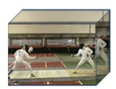
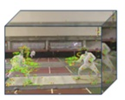
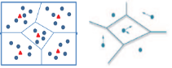
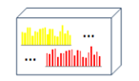
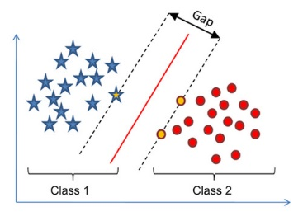
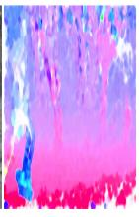
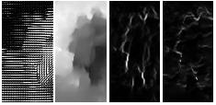
Normal Approach
Feature Extraction
Video Representation
Video
Classifier
GMM+ Fisher Vector

Slide 5
Motivation
Last three decades
Feature generation methods are created
Single view Video Action Recognition
Cross-View is still a new topic in action recognition in videos
Dictionary Learning
Discriminative Feature
Performance Detroit for cross-view action recognition
“what you see” is different in another view “what you recognize”
Transfer Learning
Data distribution or feature space changes
Common subspace

Slide 6
Transfer Learning
Data used in training a classifier
Data must be properly chosen
Data should be representative
If not? Accuracy will be worse
But suppose we want to apply a classifier to a new or shifting domain? Retrain?
But that’s expensive
Use our existing classifier as a starting point to give us shortcut
This is Transfer Learning
Based on https://project.dke.maastrichtuniversity.nl/datamining/2013-Slides/transfer-01.ppt
Notes:
Data used in training a classifier must be properly chosen to be representative
If not? Accuracy will be worse
But suppose we want to apply a classifier to a new or shifting domain? Retrain?
But that’s expensive
Can we somehow use our existing classifier as a starting point to give us shortcut
This is Transfer Learning

Slide 7
Traditional Learning VS Transfer Learning
Different Tasks
Source Task
Target Task
Learning System
Learning System
Learning System
Knowledge
Learning System
Traditional Machine Learning
Transfer Learning
copyright Paula Matuszek 2016
Based on https://project.dke.maastrichtuniversity.nl/datamining/2013-Slides/transfer-01.ppt

Slide 8
Dictionary Learning
Hand Crafter Features
High Accuracy
Can not adapted to new conditions
Learning Feature from Data itself
Overcome limitation
Low Level Features
Dictionary Learning
Fast representation under sparse representation theory
Well approximated by linear combination of some bases or dictionary

Slide 9
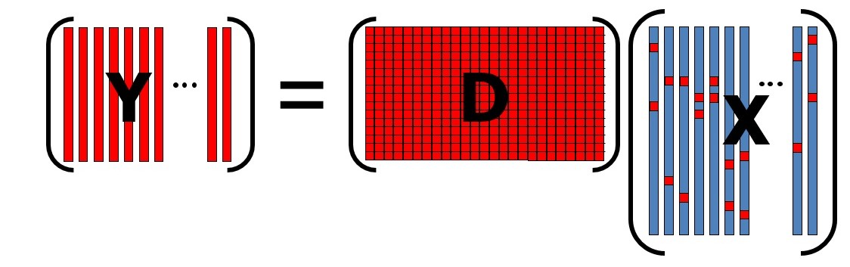
Dictionary Learning

Slide 10
Methodology

Slide 11
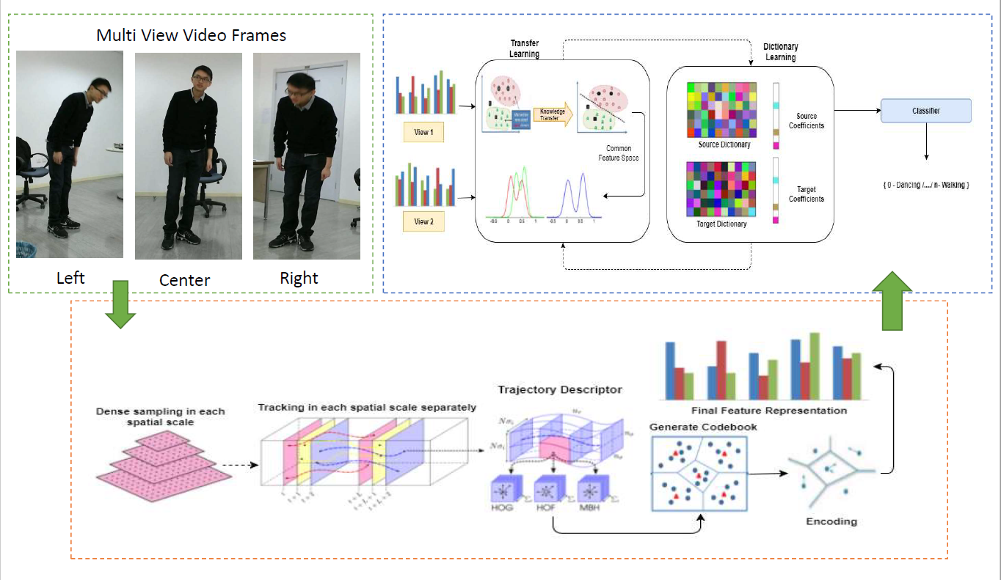
Cross-View Action Recognition via Joint Dictionary and Transfer Learning Framework

Slide 12
Cross-View Action Recognition via Joint Dictionary and Transfer Learning Framework
Three Major Steps
Feature Extraction and Codebook Generation
Improved Dense Trajectories is used for feature extraction
Gaussian Mixture Model and Fisher Vectors for visual vocabularies
Transfer Learning
Dictionary Learning
Jointly Learning

Slide 13
Action Recognition in realistic videos
Challenges
Camera motion
Cluttered background and occlusion
Viewpoint and illumination changes
Current state of the art
Improved Dense Trajectories performs the best on large variety of datasets
Improved Dense Trajectories is the extension of Dense Trajectories.

Slide 14
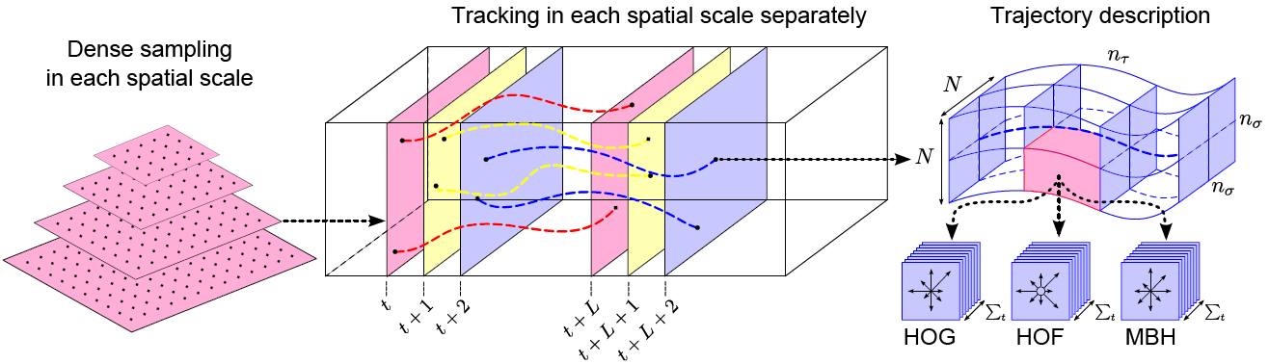
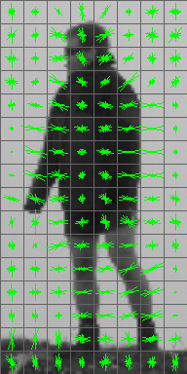

Dense trajectories revisited
Three major steps
Dense Sampling
Feature Tracking
Trajectory aligned descriptors
HOG
MBH

Slide 15
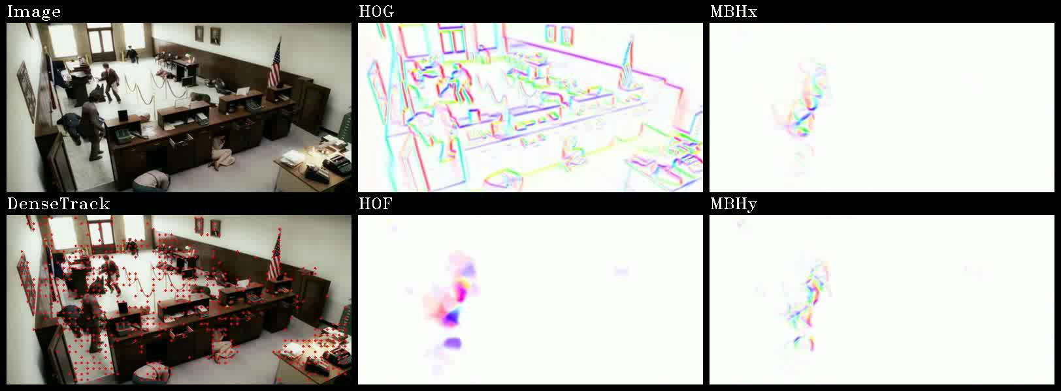
Dense trajectories revisited
Advantages:
Capture the intrinsic dynamic structure in video
MBH is robust to camera motion estimation
Disadvantages:
Generate irrelevant trajectories in background due to camera motion
Motion descriptors are corrupted due to camera motion, e.g., HOF, MBH

Slide 16
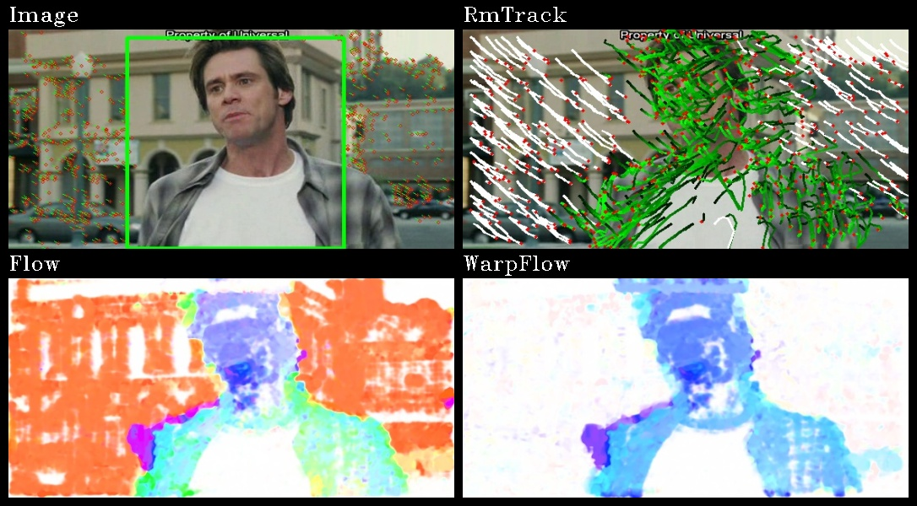
Improved Dense Trajectories
Improved dense trajectories by explicit camera motion estimation
Detect human to remove outlier matches for homography estimation
Stabilize optical flow to eliminate camera motion
Remove trajectories caused by camera motion

Slide 17
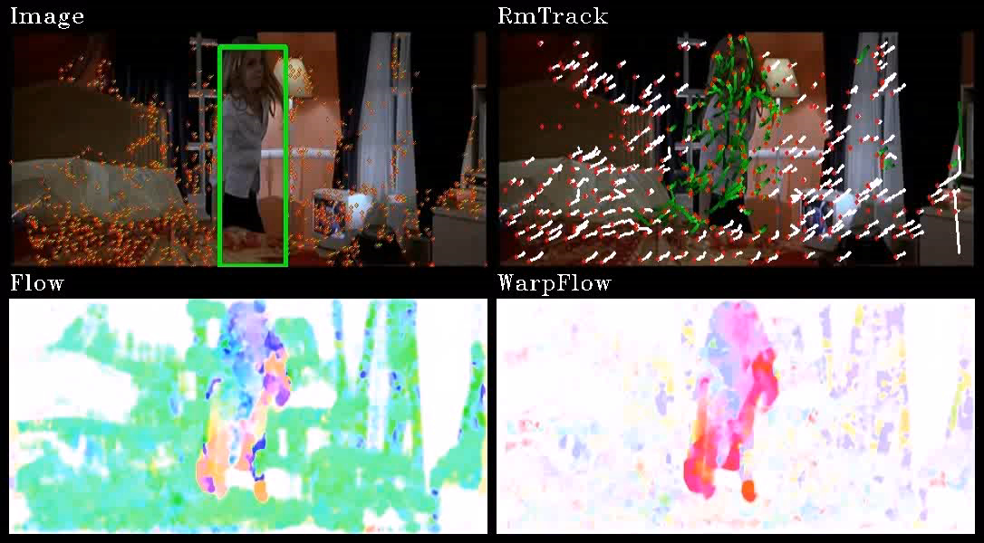
Improved Dense Trajectories

Slide 18
Improved Dense Trajectories output
The format of computed features
The first 10 element are information about Trajectory
The other elements are five descriptors
Trajectory: (30 dimensions)
HOG: 8x[spatial cells] x [spatial cells] x [temporal cells] (default 96 dimensions)
HOF: 9x[spatial cells] x [spatial cells] x [temporal cells] (default 108 dimensions)
MBHx: 8x[spatial cells] x [spatial cells] x [temporal cells] (default 96 dimensions)
MBHy: 8x[spatial cells] x [spatial cells] x [temporal cells] (default 96 dimensions)
So in total we have 436 dimension feature
While the number of features varies video to video.
[H.Wang et al. , CVPR,2011]

Slide 19
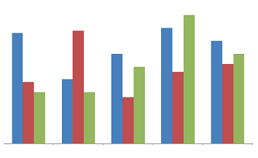
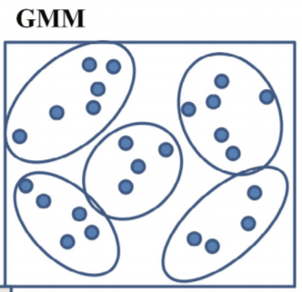
Visual Vocabularies using GMM and Fisher Vector
Fixed number of dimension for each videos
But, Feature length varies
Video to Video
Different number of frames
Different number of features in each frame
Gaussian Mixture Model and Fisher Vector
Fixed length for all videos
Fisher Vector
GMM

Slide 20
Visual Vocabularies using GMM and Fisher Vector
Visual vocabularies are built
Transform low-level feature into high level representation
Fisher vector of images has extension of popular bag of visual words
Characterize the video feature by the number of occurrence
Characterized by the gradient vector
Derived from generative probabilistic model
Gradient of log-likelihood describe the contribution of parameter.
Fisher vector
Gaussian Mixture model (GMM) with second order information
Aggregated feature vector w.r.t the mean and covariance of GMM
2*k*d features.
k = number of center, d= dimensions of data
Total = 2 * 64*426 = 54528
Notes:
Visual vocabularies are built
Transform low-level feature into high level representation
Fisher vector of images has extension of popular bag of visual words
It doesn't characterize the image by the number of occurrence
Characterized by the gradient vector
Derived from generative probabilistic model
Gradient of log-likelihood describe the contribution of parameter.
Fisher vector
Computes the Gaussian Mixture model (GMM) with second order information
Computes the aggregated feature vector w.r.t the mean and covariance of GMM
2*k*d features.
k = number of center, d= dimensions of data
Total = 2 * 128 *96 = 24576

Slide 21
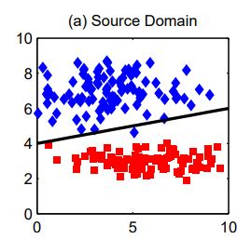
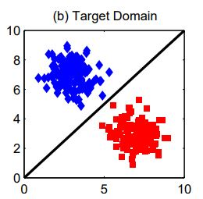
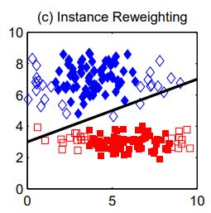
Transfer Learning Methods
Transfer Component Analysis (TCA)
Learn common space for both domain
Projecting it into common subspace
Transfer Joint Matching
Source and target domains are different
Labeled source and unlabeled target domain
Jointly perform
Feature matching
Minimizing nonparametric MMD
Infinite dimensional RKHS
Instance reweighting
Minimizing l2,1 norm structures sparsity
PCA procedure

Slide 22
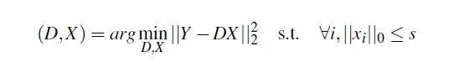
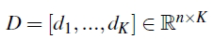
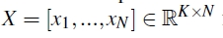
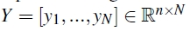
Sparse coding and Dictionary learning
Sparse coding and Dictionary learning
The K-SVD is well known for efficiently learning a dictionary.
It solves the following optimization problem:
where is the learned dictionary, and
are the sparse representations of input signals
N = number of videos
n = number of dimension
K= number of atoms

Slide 23
Sparse Coding and Dictionary Learning
Optimization problem
Two stage procedure
Sparse coding
Dictionary update
Dictionary chosen
Pre-defined dictionary
Find the sparse coding for input Y using the pre-defined dictionary
Update dictionary
Training Samples
Initialize Dictionary
Sparse coding
Update Dictionary

Slide 24
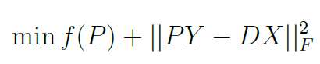
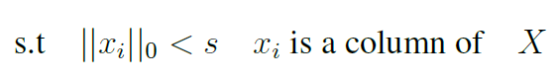
Joint Dictionary and Transfer Learning for Cross-View Action Recognition
The joint learning objective can not be solved in a closed-form
We refer to an iterative solution
Transfer Learning
Bring different views in common subspace
View Independent Dictionary
Sparse Representation of Video Features
Initialize Projection Matrix P
Initialize Dictionary
Fix D, P, find sparse X
Fix X, P update D
Fix D, X update P

Slide 25
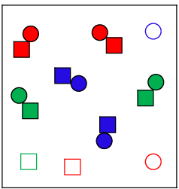
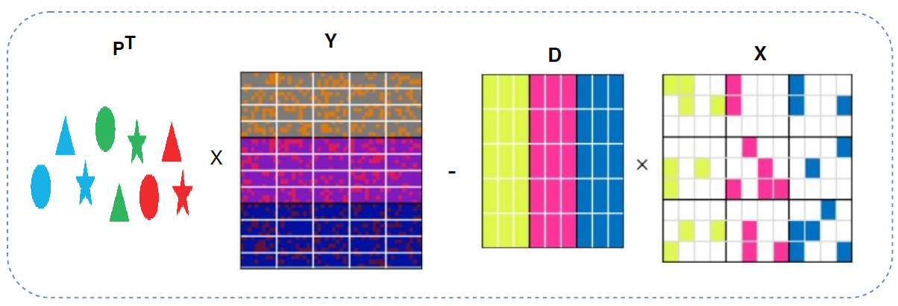
Joint Dictionary and Transfer Learning for Cross-View Action Recognition
Dictionary Learning using Transfer Learning Projection Matrix
Transfer Learning function
Y
D
X
+
P

Slide 26
Experiments

Slide 27
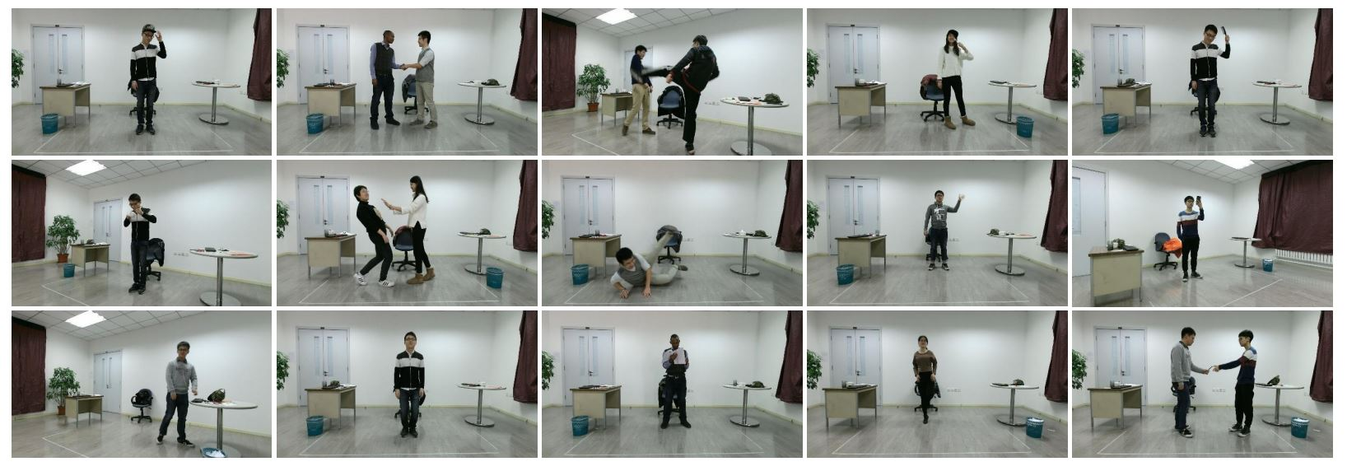
Data set and Preprocessing
Dataset
PKU-MMD dataset is used for evaluation
Data is collected from 3 different and fixed angle
Dataset consist of 51 classes
5 classes are used for evaluation

Slide 28
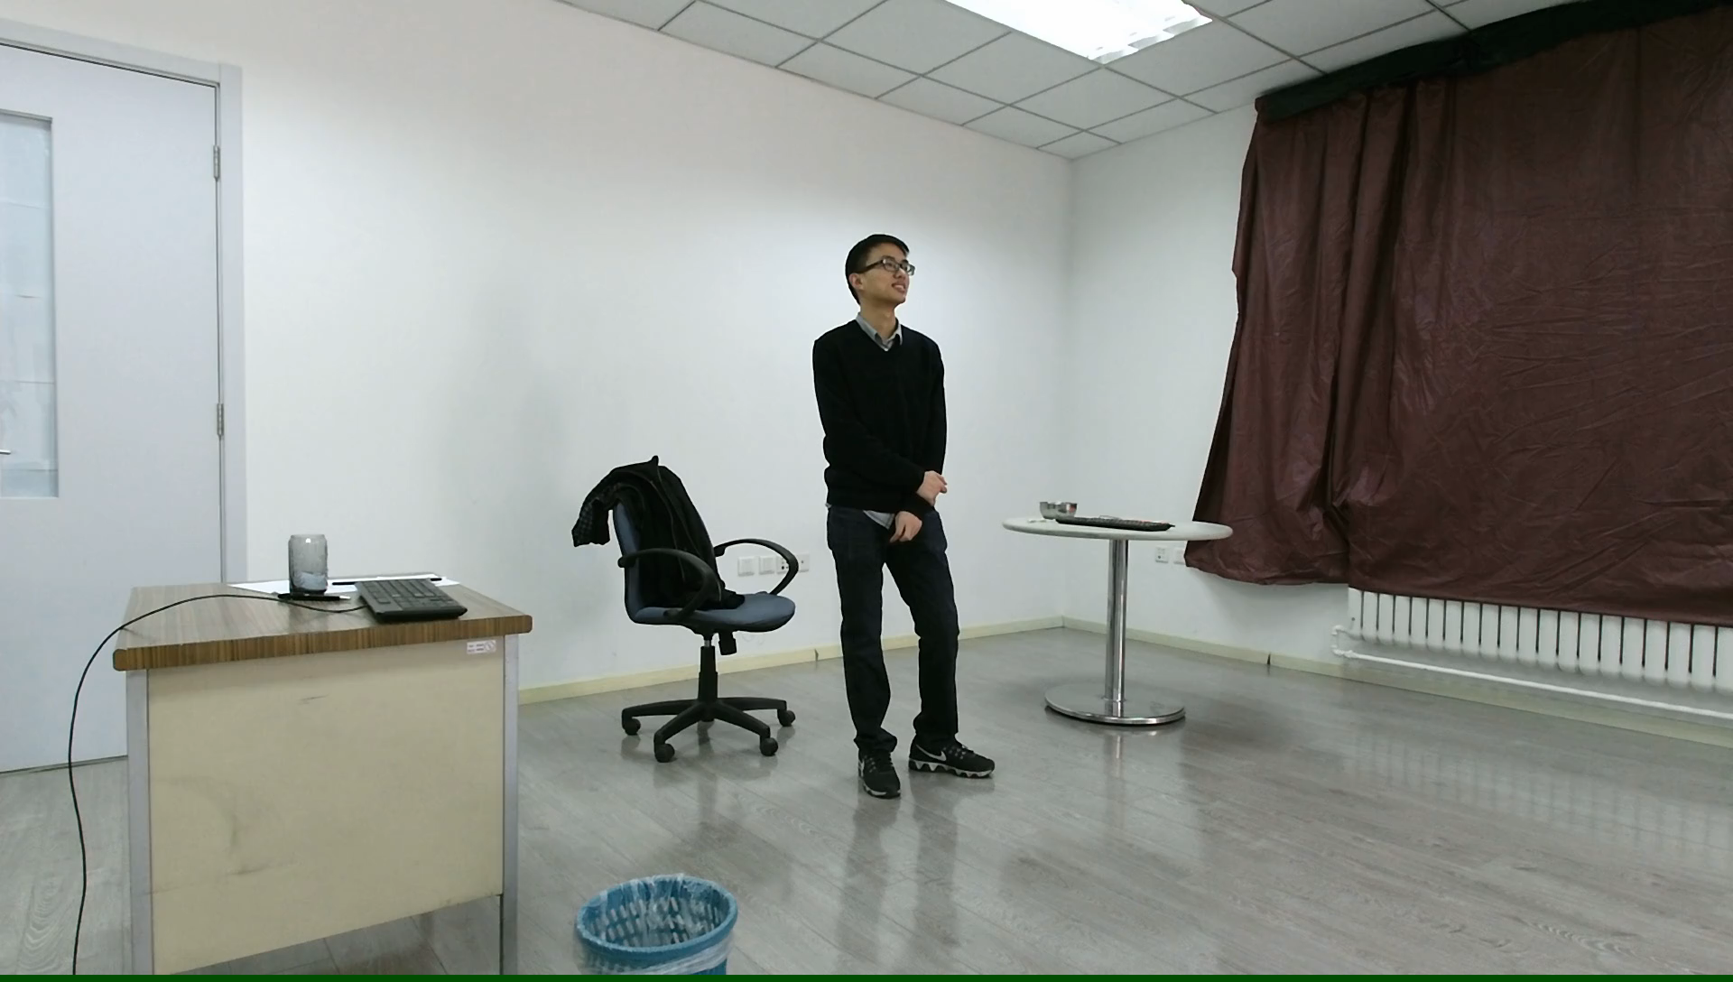
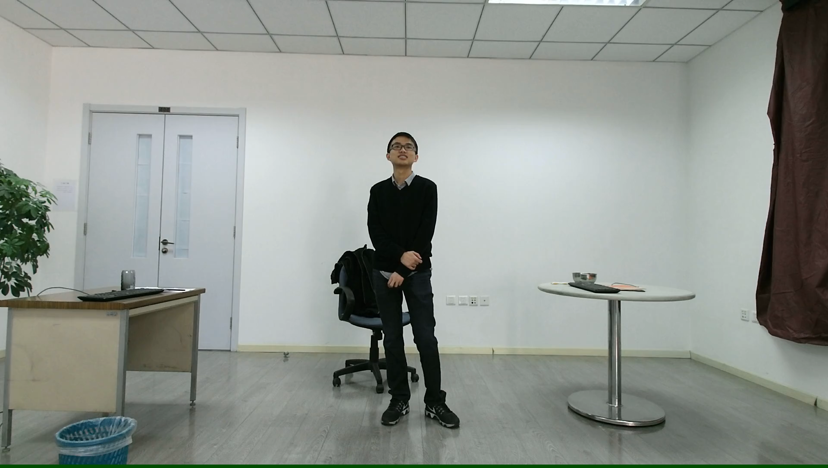
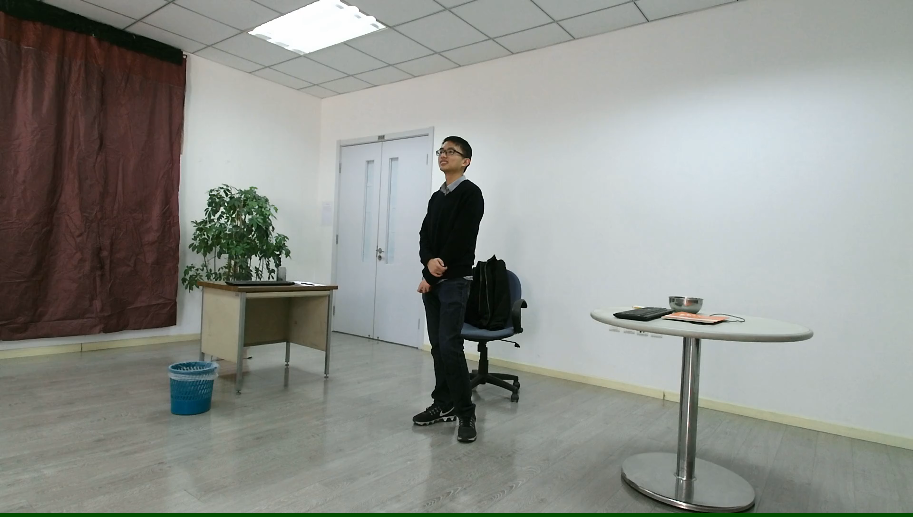
View1
View2
View3

Slide 29
Data Segmentation
1000+ long action Sequences
Each video lasts 3~4 long
20 actions approximately
Each video data label file contains
Start and ending frame
Action label information

Slide 30
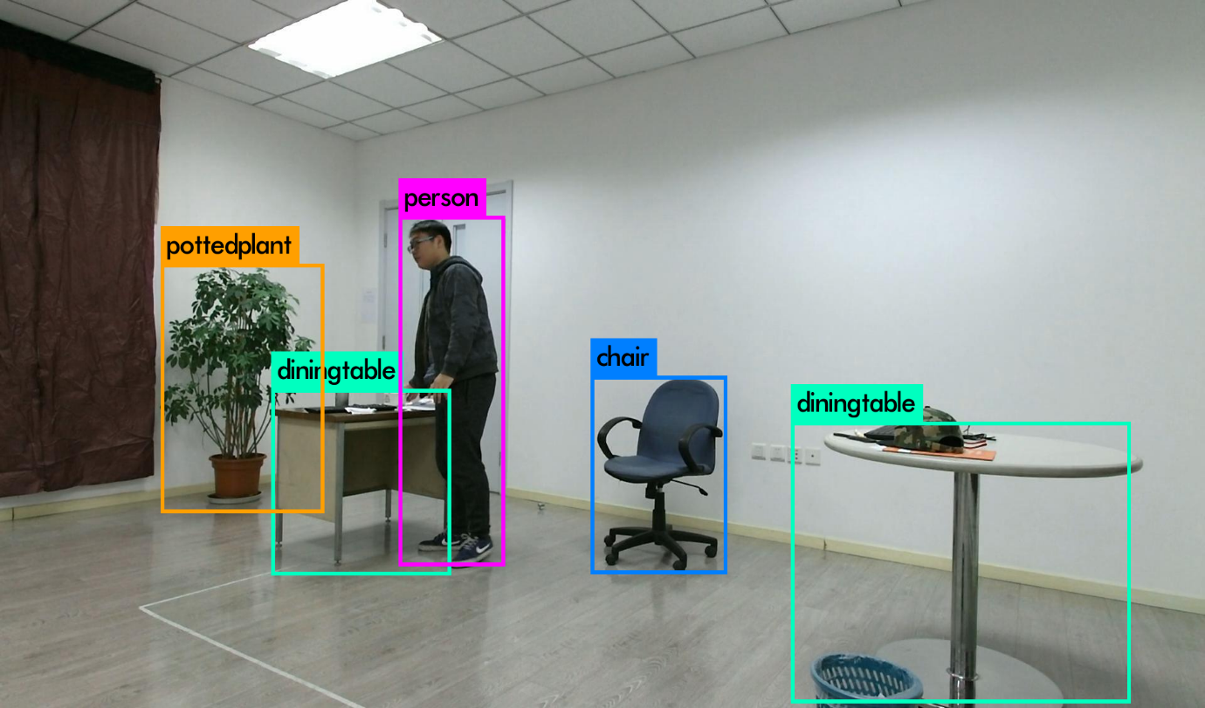
Video Frame Cropping
Data is collected through Kinect
Frame Resolution is 1920 x 1080
Action setup area
180 cm length
120 cm width
Yolo (You only live once)
Detect objects and Label them
Bounding Box information

Slide 31
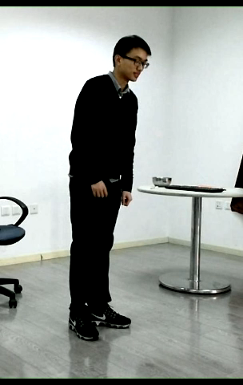
Action video after cropping and Segmentation

Slide 32
Experiment Setup
Training Data
Training data contains 620 videos
Testing data contains 87 videos
Dimension of Fisher Vector for each descriptor
Trajectory: 3840
HOG: 12228
HOF: 13824
MBH: 24576
IDT: 54528
Dimension Reduction
Principle Component Analysis
Dimension set to 400D
No dimension reduction for Transfer Learning Methods

Slide 33
Results
Comparison of IDT Descriptors
Cross-View Action Recognition without Transfer Learning
Cross-View Action Recognition with Transfer Learning
Cross-View Action Recognition with Dictionary Learning
Cross-View Action Recognition via Joint Dictionary and Transfer Learning

Slide 34
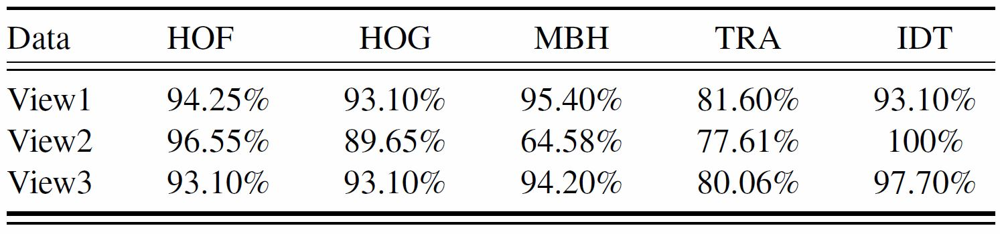
Comparison of IDT Descriptors

Slide 35
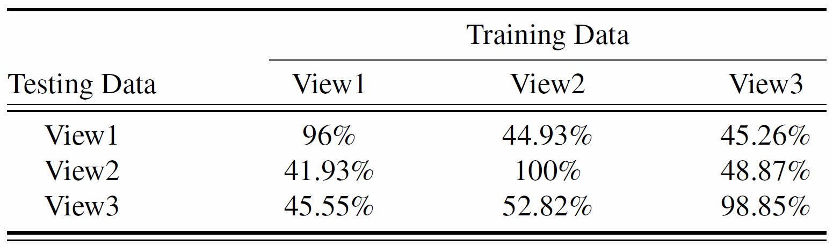
Cross-View Action Recognition without Transfer Learning

Slide 36
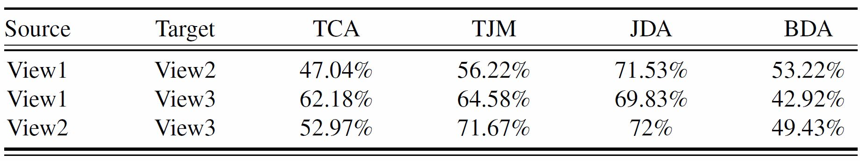
Cross-View Action Recognition with Transfer Learning

Slide 37
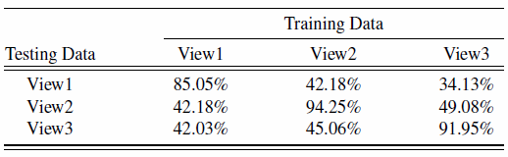
Cross-View Action Recognition with Dictionary Learning

Slide 38
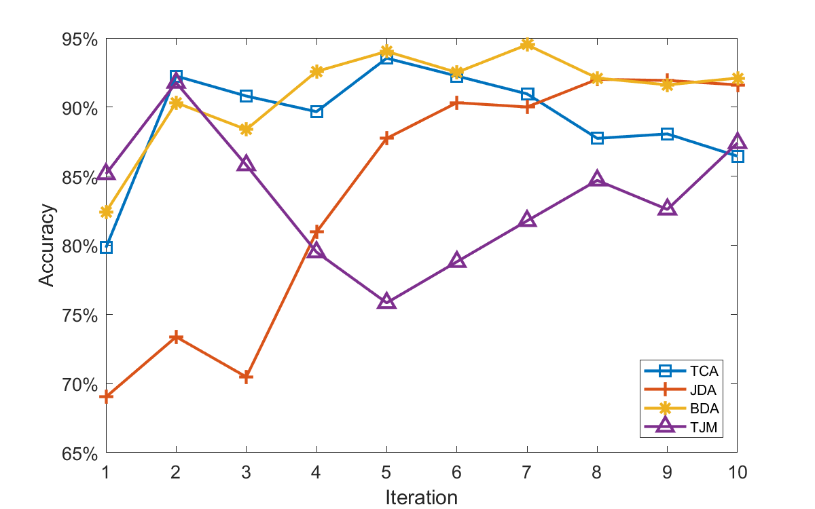
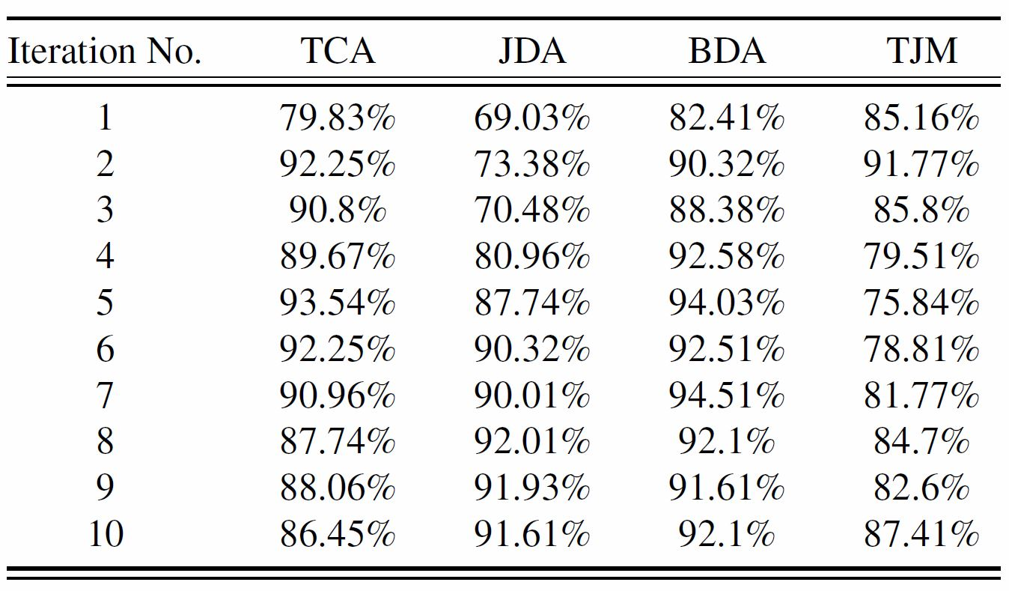
Cross-View Action Recognition via Joint Dictionary and Transfer Learning (View1- View2)
Notes:
View1-View2

Slide 39
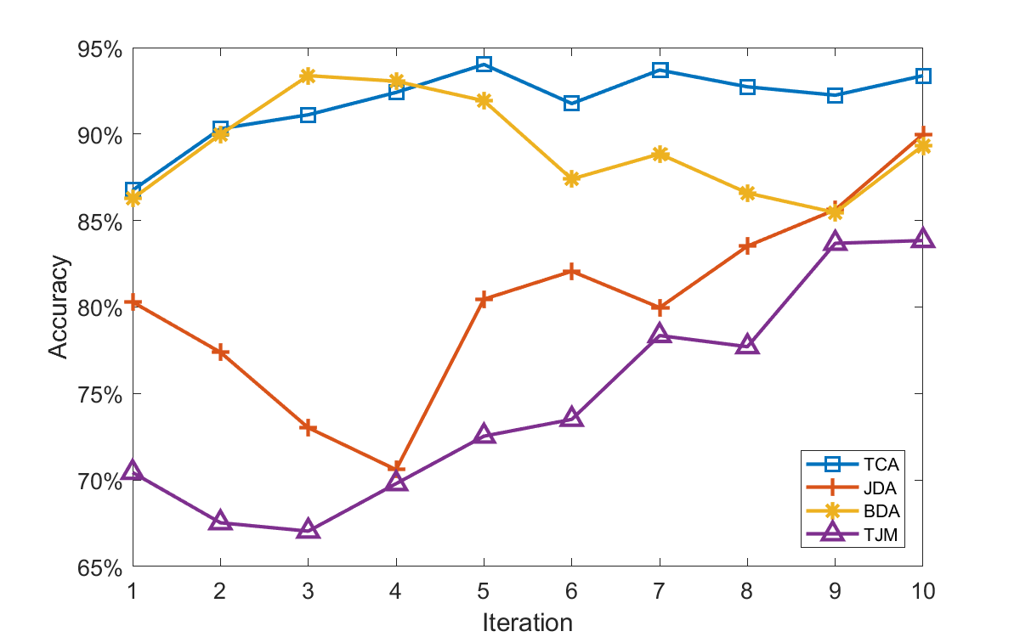
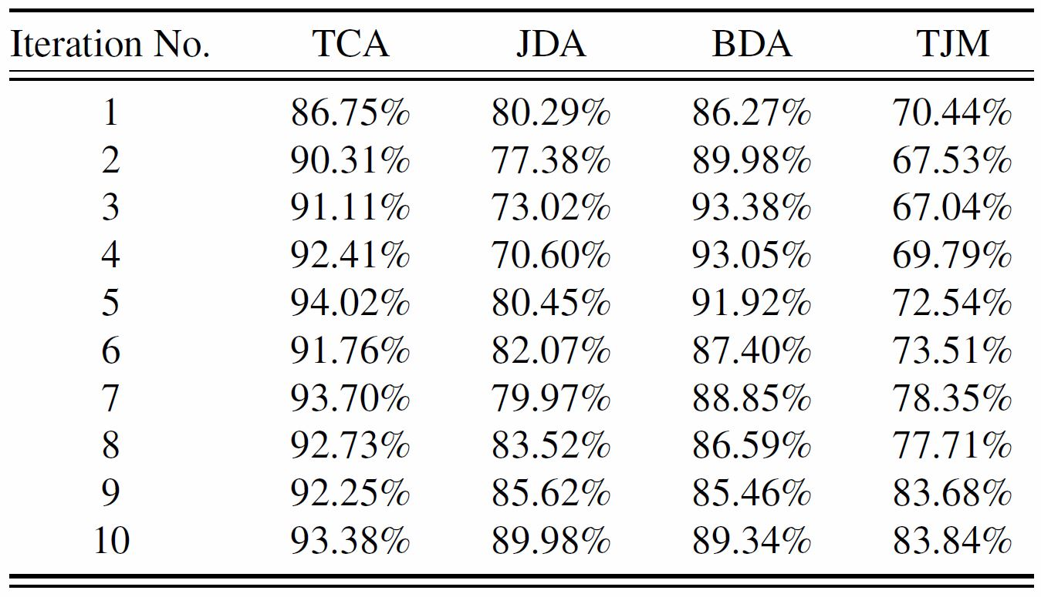
Cross-View Action Recognition via Joint Dictionary and Transfer Learning(View1-View3)
Notes:
View1-View3

Slide 40
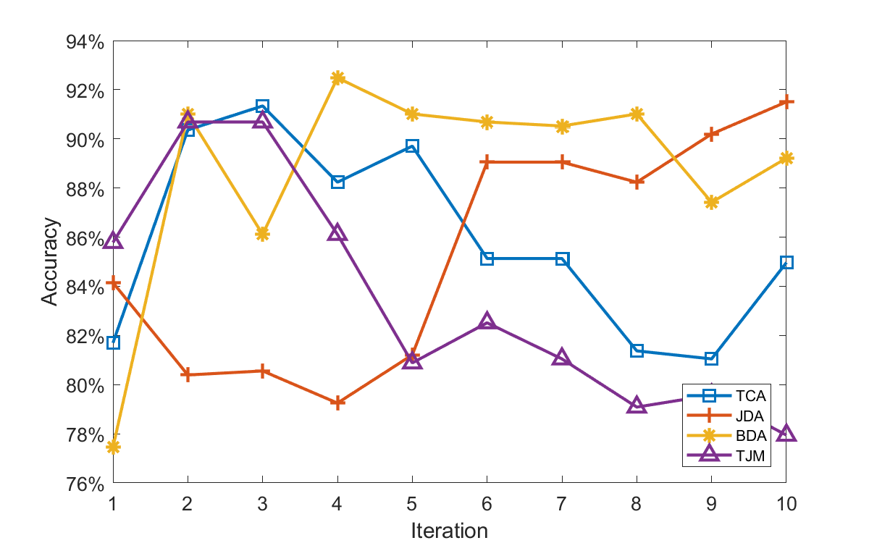
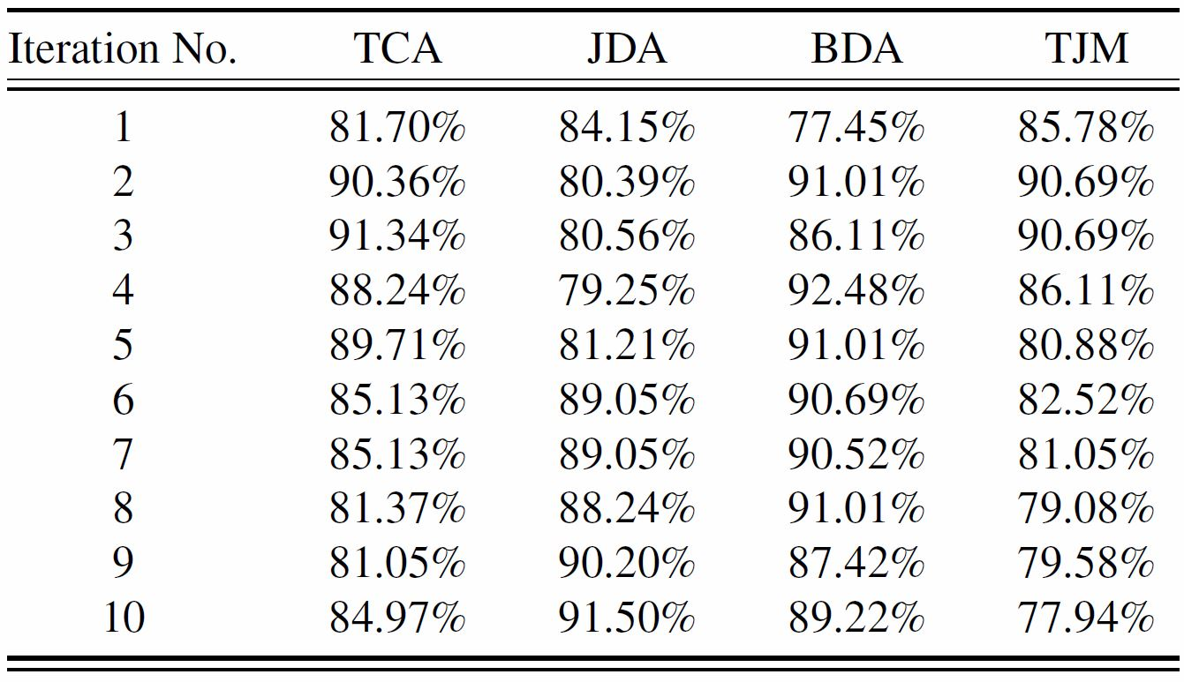
Cross-View Action Recognition via Joint Dictionary and Transfer Learning(View2-View1)
Notes:
View2-View1

Slide 41
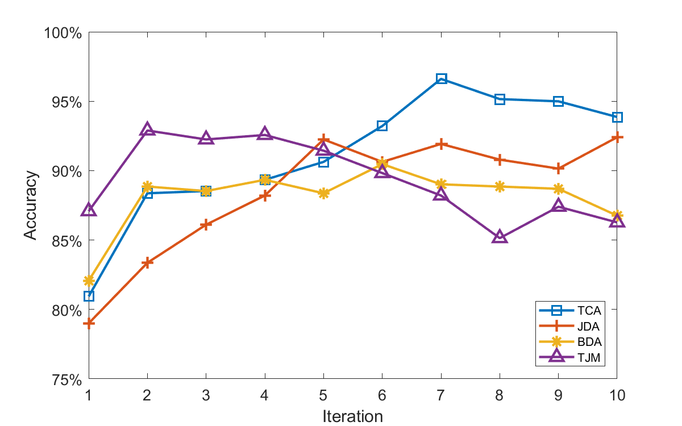
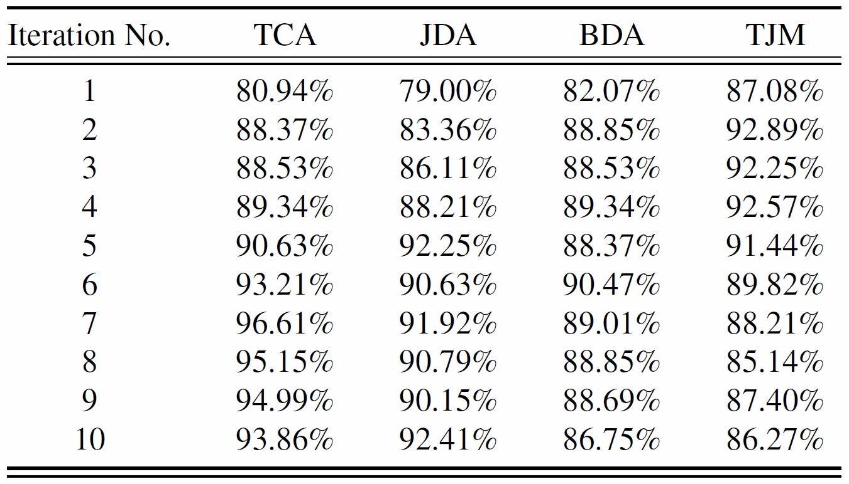
Cross-View Action Recognition via Joint Dictionary and Transfer Learning(View2-View3)
Notes:
View2-View3

Slide 42
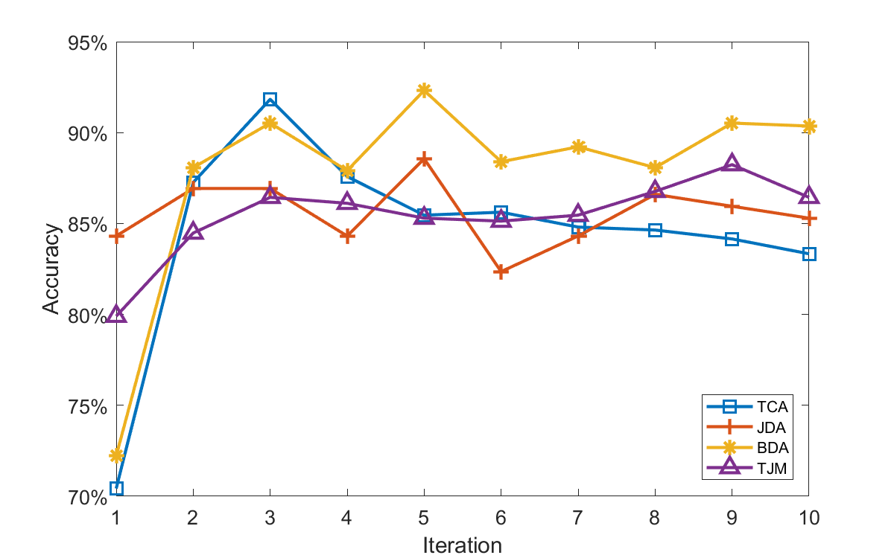
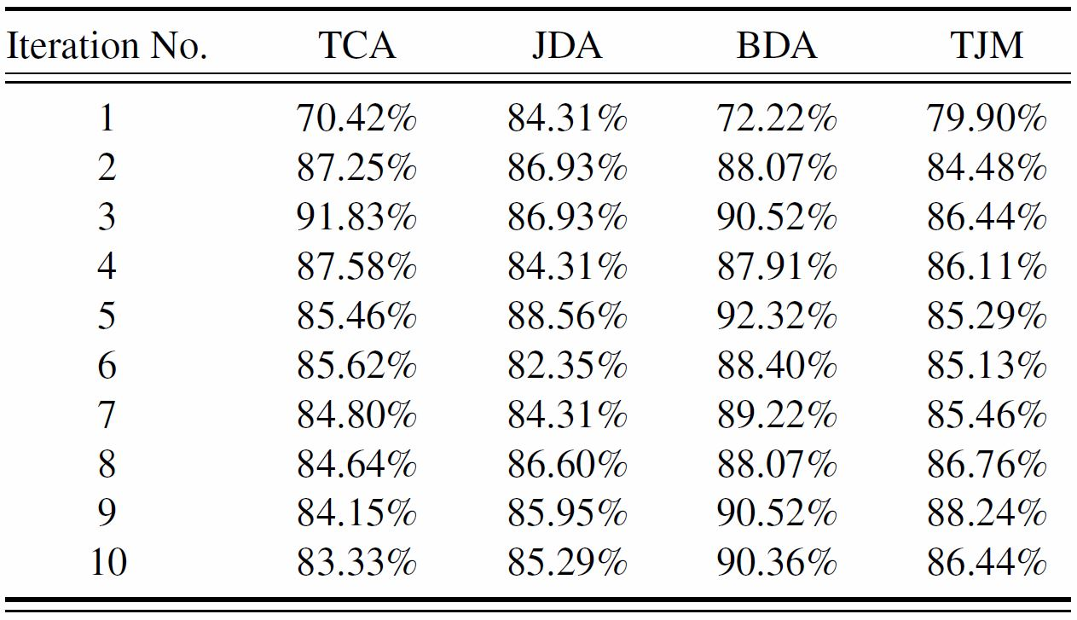
Cross-View Action Recognition via Joint Dictionary and Transfer Learning (View3-View1)
Notes:
View3-View1

Slide 43
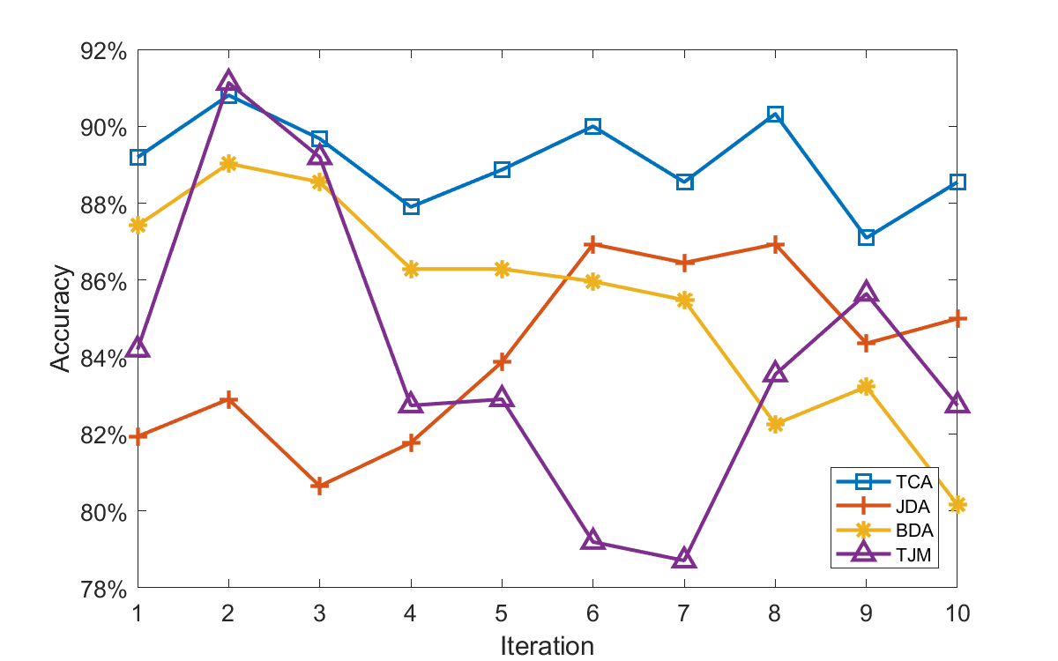
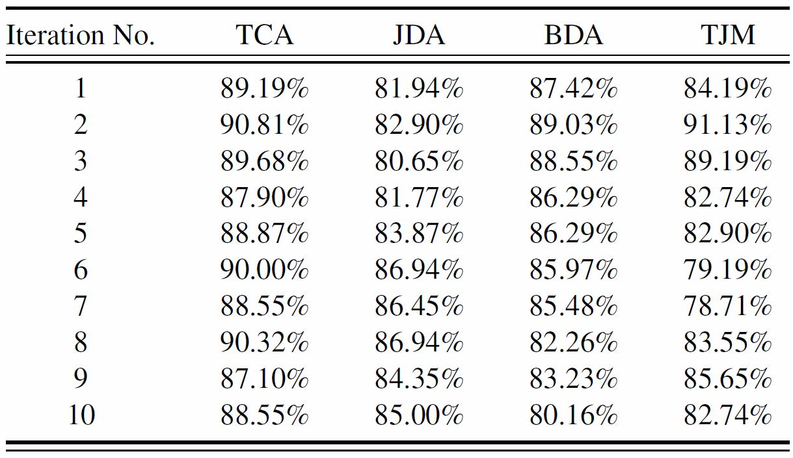
Cross-View Action Recognition via Joint Dictionary and Transfer Learning (View3- View2)
Notes:
View3-View2

Slide 44
Conclusion
Learn projection matrix got from transfer learning methods
Learned view independent dictionaries
Sparse Representation
Future work
Deep learning
This work can be extended to Zero Shot Learning

Slide 45
Thank you

